Slide 1
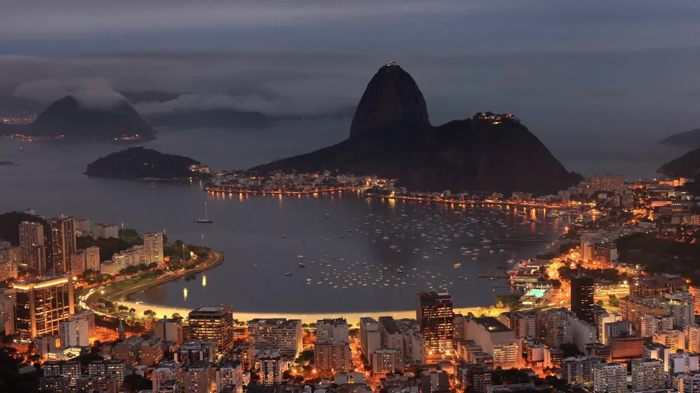
Evening Eats
A site designed by: Disha Barua, Christian Foote, and Ethan Cahill

Slide 2

Why Evening Eats?
Have you ever been stuck trying to decide where to eat?
Maybe you're in a new city?
Do you worry that the weather might wreck your evening?
Let us take care of it for you!
This Photo by Unknown author is licensed under CC BY.

Slide 3
Concept
An app designed to either use a user supplied address or their current location to display the highest rated restaurants in that area as well as the weather for the week.
Some cities have so many restaurants it can be overwhelming, and it stinks to go out when the weather is less than favorable. This app simplifies the planning for a night out.

Slide 4

Process: Technologies Used
Technologies used include:
HTML
Javascript
CSS
Tailwind
Google Places and Geocoding API
OpenWeather API

Slide 5
Tasks: Disha
Created framework for the site and added styling
Created the "My Picks" section functionality allowing Restaurants to save to local storage
Organized Team Tasks

Slide 6
Christian
Created the Display Weather functionality utilizing OpenWeather API
Developed ReadMe
Assisted in improving all JavaScript

Slide 7
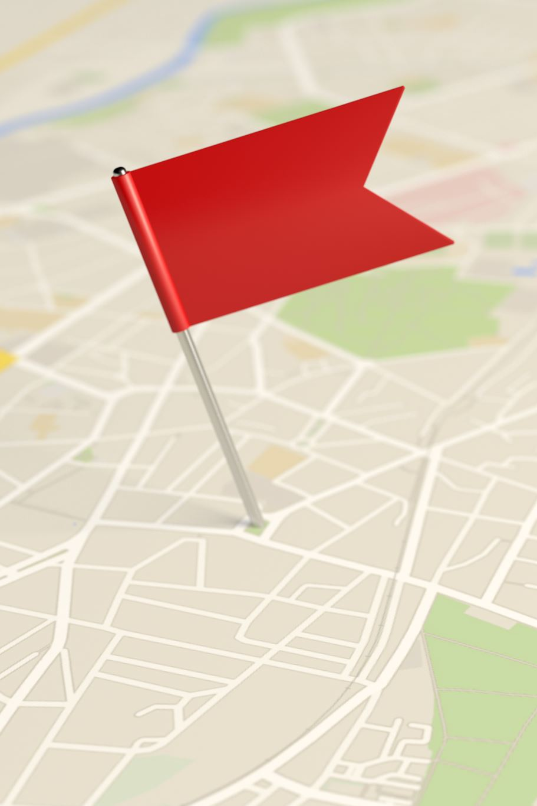
Ethan
Utilized Google API to geocode user location
Used user location to find restaurants in area
Added additional animations to site

Slide 8
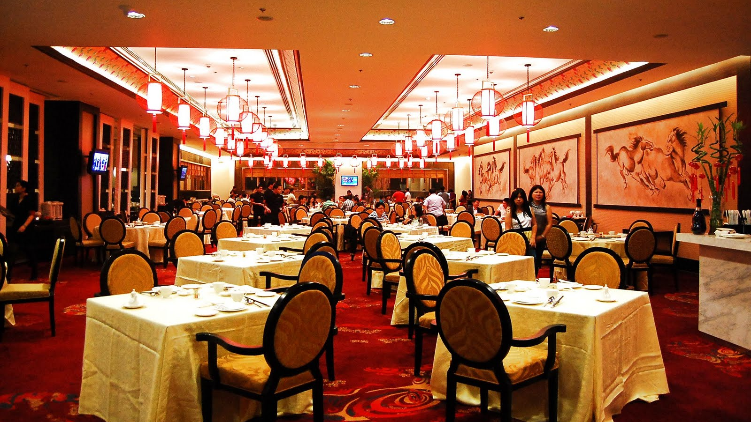
Demo of Site
https://disha2022.github.io/Interactive_Front_End_Project/
This Photo by Unknown author is licensed under CC BY-NC.

Slide 9
Future Development
Implement a mapped route for each saved restaurant
Include a link to each restaurant's website

Slide 10
Links
Live Site: https://disha2022.github.io/Interactive_Front_End_Project/
GitHub: https://github.com/Disha2022/Interactive_Front_End_Project

